Slide 1
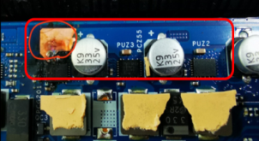
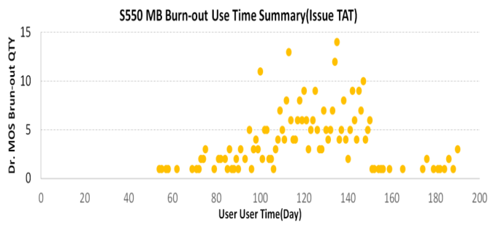
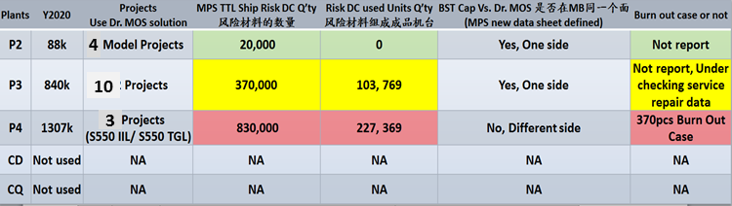
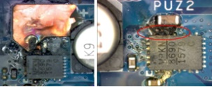
Highlight/Lowlight
Lowlight
[Field] KSP4 C38 PRC complain S550 IIL PCB burn out (MPS Dr. MOS PUZ2-4) after using 2 months, FR: 893 DPPM (370/414,049) 不良一直在增加
RC: MPS Dr. MOS material issue (MPS MP86901C, PN: SA00008ZY10), Only 550 Intel platform use Dr. MOS, Other projects use: RichTek
1). Test fixture: One of test board have weakened/ broken connection on the relay and have a spike on BST-SW at April test record
2). Test coverage: DPAT didn’t Cover BST post leakage & Hardware check coverage is not good enough (Can’t cover outlier parts)
Impact: MPS initial risk range DC: 1851, 1922, 1935, 1944, 1947, 2001, 2002 and predict FR: 0.45% (Failure Q’ty predict 1K will burn out)
It reject by Compal for fixture defect date and fix date not clearly, MP will provide final FACA and risk range on 8/27
CA:
1): Stop MPS risk range parts (DC: 1851, 1922, 1935, 1944, 1947, 2001, 2002) – 8/22 Done
2): Design change follow MPS new data sheet (Risk point didn’t define at last data sheet of MPS), Geber out: 8/21, Risk go: 40k, CR: 9/3
- Move BST Cap to same side with Dr. MOS (Current, on back side of Dr.MOS), MPS new SPEC add this to reduce spike voltage on VBST-VSW
- Remove SMT ATE test points(24 points) for Dr. MOS to avoid test fixture impact Dr. MOS, 8/12
370pcs Defect TTF

